Slide 1
ANOMALY DETECTION IN VIDEO USING RECURRENT NEURAL NETWORK AND GAUSSIAN MODEL
Under the Guidance of,
Dr.P.Kola Sujatha
Assistant prof. [Sr Grade]
By,
S.Yuvarani
2017611008

Slide 2
OUTLINE
Abstract
Introduction
Literature Review
Proposed Work
4.1 Architecture
4.2 Modules Description
Monthly Schedule up to March 2019
References

Slide 3
ABSTRACT
Anomaly detection in surveillance system demands to address various problem.
Proposed work aims to identify different anomaly with different dataset such as (USCD, UMN, QMUL, Subway, Avenue).
Gaussian Kernel Integration Model (GKIM) and Gaussian Mixture Model (GMM ) model have been used for extracting features.
Recurrent Neural Network (RNN) with Conditional Random Field (CRF) has been used for classification.
Performance Analysis between GKIM and GMM has been carried in terms of Equal Error Rate (EER) and Detection Rate (DR).

Slide 4
INTRODUCTION
Unexpected behaviour of data consider as anomaly or unusual event.
Types of anomaly :
Point anomaly
Contextual anomaly
Collective anomaly
Feature Extraction

Slide 5
INTRODUCTION(Cont..)
GMM
Generally multiple object segmentation using Gaussian Mixture Model.
Avoid the over fit of feature by using EM algorithm.
EM (Expectation – Maximization)

Slide 6
RELATED WORK
Anomaly detection
Dataset
RNN
GKIM
GMM
UMN
With anomaly
LBP
UCSD
NMD
Video
SUBWAY
QMUL
AVENUE
TRAFFIC SCENE

Slide 7
RELATED WORK( Anomaly Dataset)
S.NO | PAPER DETAILS | OBJECTIVE | STRENGTH | WEAKNESS
1 | Habib Ullah , Anomalous entities Detection and Localization in pedestrian ﬂows Publication : Neurocomputing Elsevier 2018 | Anomaly detection using GKIM,RCRF Increase performance in term of equal error rate and detection rate | RNN lack of smoothing and label bias.condition random field (CRF)over come the problem of RNN . Data Set : UCSD UMN UCD | Traffic ,Subway, Avenue Anomaly not consider.

Slide 8
S.NO | PAPER DETAILS | OBJECTIVE | STRENGTH | WEAKNESS
2 | Weixin Li, Anomaly Detection and Localization in Crowded Scenes IEEE Transactions On Pattern Analysis And Machine Intelligence,2013 | Anomaly detection in pedestrian flow Using MDT | Anomaly detection with pedestrian flow USCD UMN | Traffic junction Subway
3 | Kai-Wen Cheng Video Anomaly Detection and Localization Using Hierarchical Feature Representation and Gaussian Process Regression worldscientific International Journal of Pattern Recognition and Articial Intelligence 2015 | Local and global anomaly detection using GPR | Method achieves 80% detection rate based on the three challenging Datasets USCD Subway QMUL | False detection rate is high

Slide 9
S.NO | PAPER DETAILS | OBJECTIVE | STRENGTH | WEAKNESS
4 | Jefferson Ryan Medel Anomaly Detection in Video Using Predictive Convolution Long Short-Term Memory Networks arXiv-2016 | Detecting meaning full anomaly with small number of input with LSTM | Reconstruction in past, future frame achieve accuracy USCD Subway Avenue | Do not adapt to new (unusual) movements
5 | Mohammad Sabokrou Deep-anomaly: Fully convolutional neural network for fast anomaly detection in crowded scenes ELSEVIER 2018 | Detecting anomaly using FCN | Detection anomaly with speed and accuracy USCD | Traffic junction Subway UMN

Slide 10
RELATED WORK( GKIM)
S.NO | PAPER DETAILS | OBJECTIVE | STRENGTH | WEAKNESS
1 | K.Meena, Dr.A.Suruliandi “Local binary patterns and its variants for face recognition” IEEE-International Conference on Recent Trends in Information Technology, ICRTIT 2011 | To identify face based on LBP(Local Binary Pattern) Feature based | Variety of LBP model used CS_LBP LBPV MLBP
2 | Jeffrey Byrne “Nested Motion Descriptors” 2015 IEEE Conference on Computer Vision and Pattern Recognition (CVPR) | To identify activity and prediction in video . Here with out use of optical flow Temporal information collected using NMD(Nested Motion Descriptor) | Log spiral normalization remove the unwanted camera moves

Slide 11
RELATED WORK( GMM)
S.NO | PAPER DETAILS | OBJECTIVE | STRENGTH | WEAKNESS
1 | V.Bolon-Canedo GMM based feature extraction technique for automated diagnosis of retinopathy of prematurity ELSEVIER 2017 | Extract feature from point on the vessel segment for finding disease | Result achieving 90% | -
2 | Jesus Olivares-Mercado Feature Extraction and Face Verification Using Gabor and Gaussian Mixture Models International Conference on Project MANagement / HCist - International Confer 2017 | Identify the face and verification | Result achieved 95% | Not try in video processing

Slide 12
RELATED WORK( RNN)
S.NO | PAPER DETAILS | OBJECTIVE | STRENGTH | WEAKNESS
1 | Anvardh Nanduri (M.S.), ANOMALY DETECTION IN AIRCRAFT DATA USING RECURRENT NEURAL NETWORKS (RNN) 2016 Integrated Communications Navigation and Surveillance (ICNS) Conference,2016 | Anomaly Detection in multi variant and time serious data RNN | Out of 11 9 are identified | Combination of feature are not be tested
2 | Xu-gang Zhou Abnormal Event Detection using Recurrent Neural Network(2015 International Conference on Computer Science and Applications) | Anomaly detection using RNN with auto encoder | Based on historical data its predict anomaly | Subway UCD UMN UCSD

Slide 13
PROPOSED WORK
Anomaly detection in different data set.
Performance analysis of GKIM and GMM in term of equal error rate and detection rate.

Slide 14
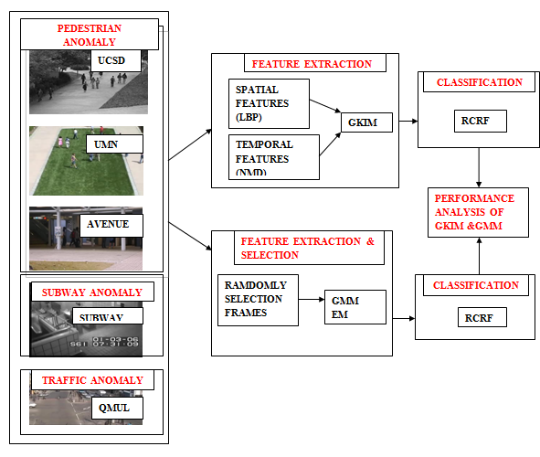
ARCHITECTURE MODEL

Slide 15
MODULE OF PROPOSED WORK
Modules
Module 1: Randomly select frames
Module 2: Feature Extraction
GMM with EM
Module 3: Classification using RCRF
Module 4 : Performance analysis GKIM and GMM

Slide 16
DATASET
S.NO | DATASET | NAME OF ANOMALY | TRAINING&TESTING
1 | UCSD(University of California San Diego) peds1 peds2 | Movement and behaviour of pedestrian Car, cyclist | ped1:34 for training 36 for testing Ped2 :16 for training 14 for testing
2 | UMN(University of Minnesota) | Panic event (people running) | 12 minutes video

Slide 17
S:NO | DATASET | NAME OF ANOMALY | TRAINING&TESTING
3 | Subway Entrance and Exit | Walking wrong direction , loitering | 1.30 minutes videos
4 | Avenue | Running, Movement and behavior of pedestrian Car , cyclist | 16 minutes for training 21 minutes for testing
5 | QMUL(Queen Mary University of Landon) | Illegal turns, Bag dropping | 60 minutes video

Slide 18
MODULE 1 – RANDOMLY SELECTION OF FRAMES
Input : Video
Output : Frames
Process :
Step 1 : Read video using VideoReader( Location of video).
Step 2 : From the total number of frames select random frames using randi
Step 3 : Name format of image.
Step 4 : Write image on specified location.

Slide 19
Number of frames
Before randomization number of frames | After randomization number of frames
1364 | 1200
1511 | 900
1487 | 1000
1511 | 957
900 | 530
1511 | 952
1100 | 700
1150 | 651
1400 | 700

Slide 20
MODULE 2- FEATURE EXTRACTION
Gaussian mixture model for multiple object tracking.
In video need to consider multiple objects .
GMM best in feature extraction and selection in speech data and multiple object tracking.
STEPS:
Extract features.
Select feature based on EM algorithm.

Slide 21
GMM Feature Extraction
Input : frames
Output : EM iteration values
Algorithm :
Step 1 : Read images from specified file location.
Step 2 : Gaussian blur
Step 3 : gmdistribution fit( )
k-means
gmm components
Step 4 : Initialize EM iteration values
Step 5 : Continues EM iteration until its converge

Slide 22
GMM Feature Extraction (cont..)
Gaussian blur :
Gaussian smoothing kernel with SD return the blur image.
Here multidimensional image filter used (imfilter)

Slide 23
GMM Feature Extraction (cont..)
Gmdistribution fit( )
using k-mean group based on color of image.
Need to reshape image (M*N)
pass the reshape image into GMM function for fit. (x,Y,g)
x – k mean image
Y – reshape
g - number of gaussian cells

Slide 24
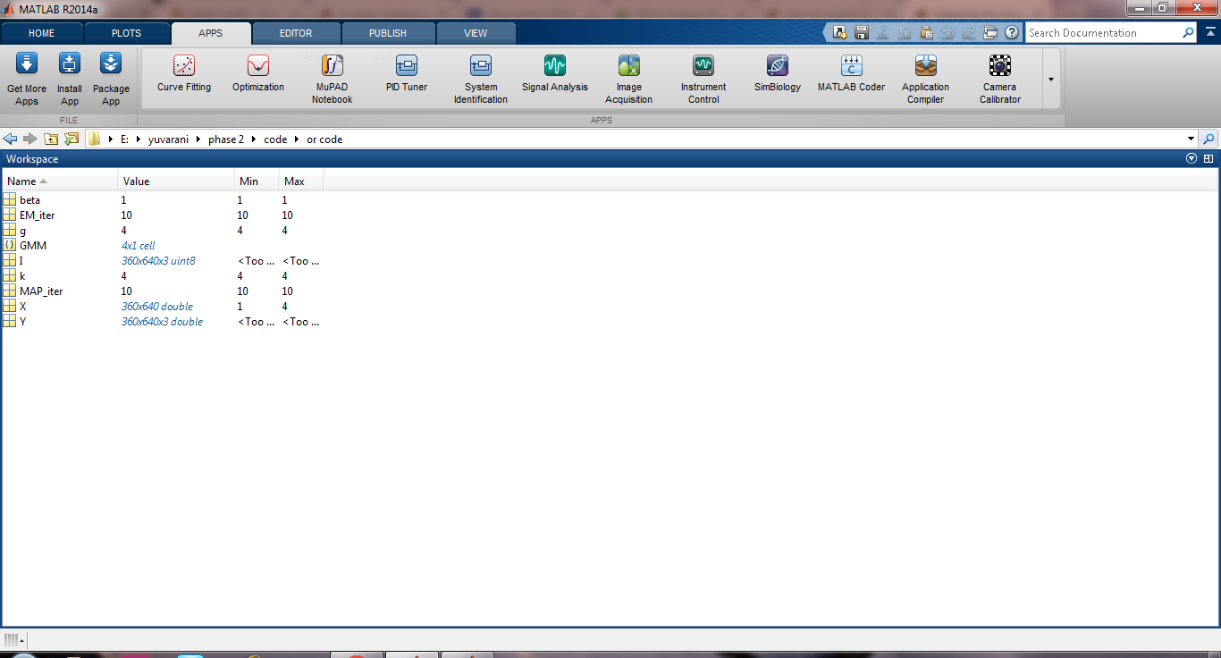
GMM Feature Extraction (cont..)

Slide 25
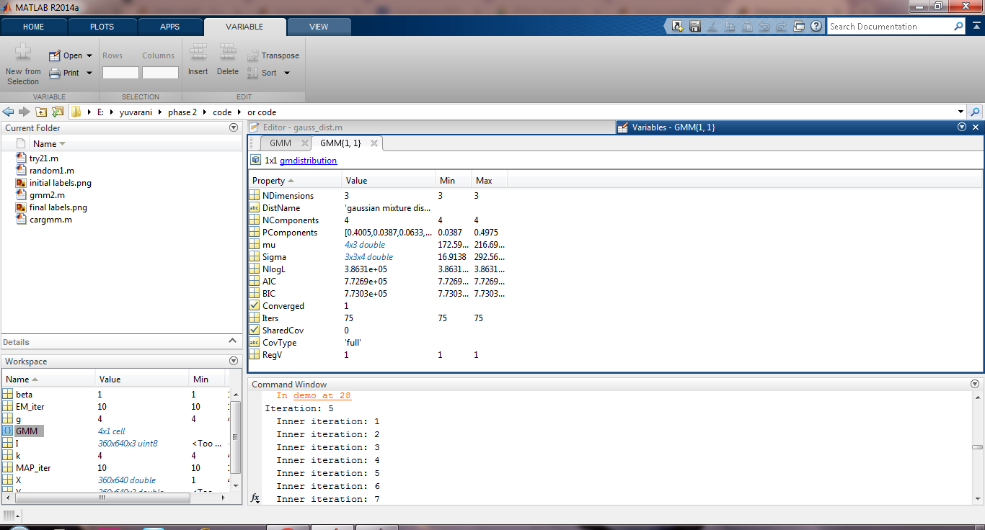
GMM Feature Extraction (cont..)
GMM distribution properties :

Slide 26
GMM Feature Extraction (cont..)
Likelihood function :
AIC = -2 * ln (likelihood) + 2 * p
BIC = -2 * ln (likelihood) + ln (N)*p
Where
P= number of estimation parameter
N= sample size

Slide 27
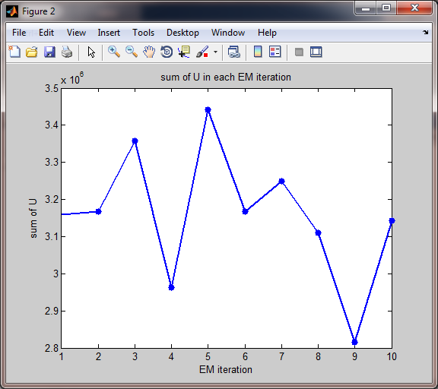
GMM Feature Extraction (cont..)

Slide 28
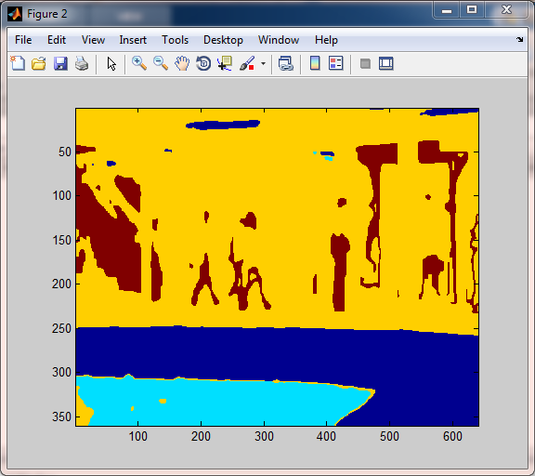
GMM Feature Extraction (cont..)

Slide 29
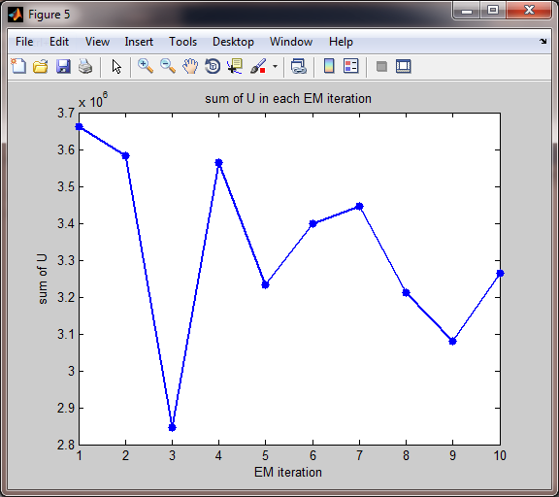
GMM Feature Extraction (cont..)

Slide 30
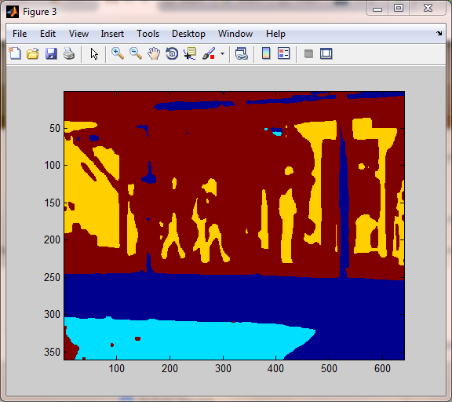
GMM Feature Extraction (cont..)

Slide 31
MODULE 3 - CLASSIFICATION
RCRF (Recurrent – Conditional Random Field)
Training and testing using recurrent neural network with conditional random fields.
Deep learning technique having issues in visualize the object not clear in edge.
Using Conditional random field edges are very sharp.
Feature are input for RNN

Slide 32
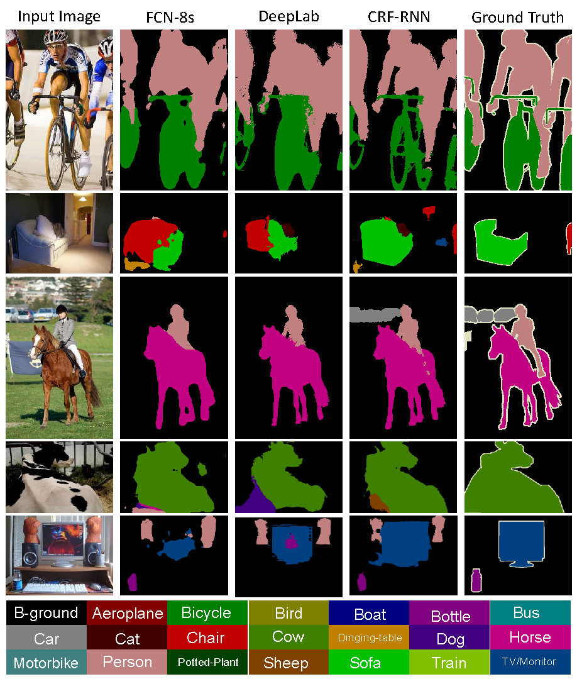

Slide 33
RNN STEPS
Input : Feature of frames
Output : Accuracy of trained data
Step 1: collect the data
Step 2 : create network
Step 3 : configure the network ,initialize the weight and bias values
Step 4: Train the network
Step 5: validation of network
Step 6: use the network

Slide 34
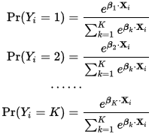
ACTIVATION FUNCTION
Hidden layer : tanh function.
Output layer : Softmax fuction
Used in multiple classification logistic regression model.
In building neural networks softmax functions used in different layer level.

Slide 35
RESULT ANALYSIS
EXPERIMENTAL SETUP
MATLAB 2017a
6 GB RAM
Intel i5 processor

Slide 36
SCHEDULE
Randomly select frames | December
Feature Extraction GMM EM | January
RCRF | February
Performance analysis | March

Slide 37
CONCLUSION
To deal with different anomaly detection
Performance analysis of GMM in term of EER and DR
Compare GKIM and GMM

Slide 38
REFERENCES
1. Weixin Li, Student Member, IEEE, Vijay Mahadevan, Member, IEEE, and Nuno Vasconcelos,SeniorMember,IEEE “Anomaly Detection and Localization in Crowded Scenes” IEEE Transactions On Pattern Analysis And Machine Intelligence,2013
2. Kai-Wen Cheng ,Dan Xu, Yen-Lun Chen “Video Anomaly Detection and Localization Using Hierarchical”
Feature Representation and Gaussian Process Regression” Worldscientific , International Journal 2015
3. Jefferson Ryan Medel Andreas Savakis “ Anomaly Detection in Video Using Predictive Convolution
Long Short-Term Memory Networks “ arXiv-2016
4. Mohammad Sabokrou, Mohsen Fayyaz1,Zahra. Moayedc, Reinhard Klettec “Deep-anomaly: Fully
convolutional neural network for fast anomaly detection in crowded scenes” ELSEVIER 2018

Slide 39
5. Roberto Leyva, Victor Sanchez, Member, IEEE, and Chang-Tsun Li, Senior Member, IEEE “Video Anomaly Detection With Compact Feature Sets for Online Performance” IEEE Transactions On Image Processing, Vol. 26, No. 7, July 2017
6. Jagannadan Varadarajan, L. Andrade, “Topic Models for Scene Analysis and Abnormality Detection”
Published in the ICCV Visual Surveillance (ICCV-VS) workshop, Kyoto, 2009
7. Ernest0 L. Andrade, Scott Blunsden and Robert B. Fisher “Characterizations of Optical Flow Anomalies in Pedestrian Traffic” IEEE international symposium on imaging for Crime Detection 2005
8. Borislav Anti´c and Bj ¨orn Ommer “Video Parsing for Abnormality Detection”IEEE International Conference on computer vision 2011

Slide 40
9. Subutai Ahmad , Alexander Lavin, Zuha Agha “Unsupervised real-time anomaly detection for streaming data” (Elsevier 2016)
10. Yan Shi a,b , Min Deng c, ⁎, Xuexi Yang c , Jianya Gong a,b “Detecting anomalies in spatio temporal flow data by constructing dynamic neighbourhoods” (Elsevier 2017)
11. Weiqi Yuan, Ji Wang “Gaussian mixture model based on the number of moving vehicle detection algorithm” 2012 International conference on Intelligent Controls
12. Borislav Anti´c and Bj orn Ommer “New road anomaly detection and characterization algorithm for autonomous vehicles” Applied Computing and Informatics (2018)

Slide 41
14. Xianghao Zang, Ge Li, Zhihao Li, Nannan Li, Wenmin Wang “An Object-aware Anomaly Detection and Localization in Surveillance Videos” (2016 IEEE Second International Conference on Multimedia Big Data)
15. Nuno Silvaa*, João Soaresa, Vaibhav Shaha, Maribel Yasmina Santosa, Helena Rodrigues
“Anomaly detection in road with data mining Approach” (elsevier 2017)
16. Hamidreza Rabiee1 · Hossein Mousavi2 · Moin Nabi3 · Mahdyar Ravanbakhsh4 “Detection and localization of crowd behavior using a novel tracklet-based model” International jouranl of machine learning and cybernetics springer 2017
17. Rensso Victor Hugo Mora Colque, “Histograms of Optical Flow Orientation and Magnitude to Detect Anomalous Events in Videos” 2015 28th SIBGRAPI Conference on Graphics, Patterns

Slide 42
18. Chengbiao Wan∗, Mengchun Pan, Qi Zhang, Fenghe Wu, Long Pan, Xiaoyong Sun “Magnetic anomaly detection based on stochastic resonance” ELSEVIER 2018
19. Peter Brauna, Alfredo Cuzzocreab, Lam M.V. Doana, Suyoung Kima, “Enhanced Prediction of User-Preferred YouTube Videos Based on Cleaned Viewing Pattern History” International Conference on Knowledge Based and Intelligent Information and Engineering Systems, KES2017, 6-8 September 2017
20 Bol´on-Canedoa, E. Ataer-Cansizoglub, D. Erdogmusb, J. Kalpathy-Cramerc, M.F. Chiangd
“GMM based feature extraction technique for automated diagnosis of retinopathy of prematurity”
ELSEVIER 2017
21. Jesus Olivares-Mercado, Gabriel Sanchez-Perez, Mariko Nakano-Miyatake, and Hector Perez-Meana
“Feature Extraction and Face Verification Using Gabor and Gaussian Mixture Models” International Conference on Project MANagement / HCist - International Confer 2017

Slide 43
22. Anvardh Nanduri (M.S.), Lance Sherry (Ph.D.) “ANOMALY DETECTION IN AIRCRAFT DATA USING RECURRENT NEURAL NETWORKS (RNN)”2016 Integrated Communications Navigation
and Surveillance (ICNS) Conference,2016
Xu-gang Zhou, Li-qing Zhang “ABNORMAL EVENT DETECTION USING RECURRENT NEURAL NETWORK” (2015 International Conference on Computer Science and Applications)
K.Meena, Dr.A.Suruliandi “LOCAL BINARY PATTERNS AND ITS VARIANTS FOR FACE RECOGNITION” IEEE-International Conference on Recent Trends in Information Technology.
Jeffrey Byrne “Nested Motion Descriptors” 2015 IEEE Conference on Computer Vision and Pattern Recognition (CVPR)
Zhijun Yao, Wenyu Liu “Extracting robust distribution using adaptive Gaussian Mixture Model and online feature selection “ELSEVIER 2013

Slide 44
C I Patel, R Patel “Gaussian Mixture Model Based Moving Object Detection from Video Sequence” International Conference and Workshop on Emerging Trends in Technology (ICWET 2011) – TCET, Mumbai, India
Haim Permuter,Joseph Francos, Ian Jermyn “A study of Gaussian mixture models of color and texture features for image classification and segmentation” ELSEVIER 2005

Slide 45



